Slide 1
Classification
There are classification tasks that you may encounter;
  Binary Classification
  Multi-Class Classification
  Multi-Label Classification
  Imbalanced Classification
shorturl.at/gEOXY
Notes:
Machine learning is a field of study and is concerned with algorithms that learn from examples.
Classification is a task that requires the use of machine learning algorithms that learn how to assign a class label to examples from the problem domain. An easy to understand example is classifying emails as “spam” or “not spam.”
Binary classification refers to predicting one of two classes and multi-class classification involves predicting one of more than two classes.
Multi-label classification involves predicting one or more classes for each example and imbalanced classification refers to classification tasks where the distribution of examples across the classes is not equal.
Classification is a type of supervised learning. It specifies the class to which data elements belong to and is best used when the output has finite and discrete values. It predicts a class for an input variable as well.

Slide 2
Classification: Use Cases
Some of the key areas where classification cases are being used:
  To find whether an email received is a spam or ham
  To identify customer segments
  To find if a bank loan is granted
  To identify if a kid will pass or fail in an examination
shorturl.at/qvLVY
Notes:
In machine learning, classification refers to a predictive modeling problem where a class label is predicted for a given example of input data.
Examples of classification problems include:
Given an example, classify if it is spam or not.
Given a handwritten character, classify it as one of the known characters.
Given recent user behavior, classify as churn or not.
A model will use the training dataset and will calculate how to best map examples of input data to specific class labels. As such, the training dataset must be sufficiently representative of the problem and have many examples of each class label.
Class labels are often string values, e.g. “spam,” “not spam,” and must be mapped to numeric values before being provided to an algorithm for modeling. This is often referred to as label encoding, where a unique integer is assigned to each class label, e.g. “spam” = 0, “no spam” = 1.

Slide 3
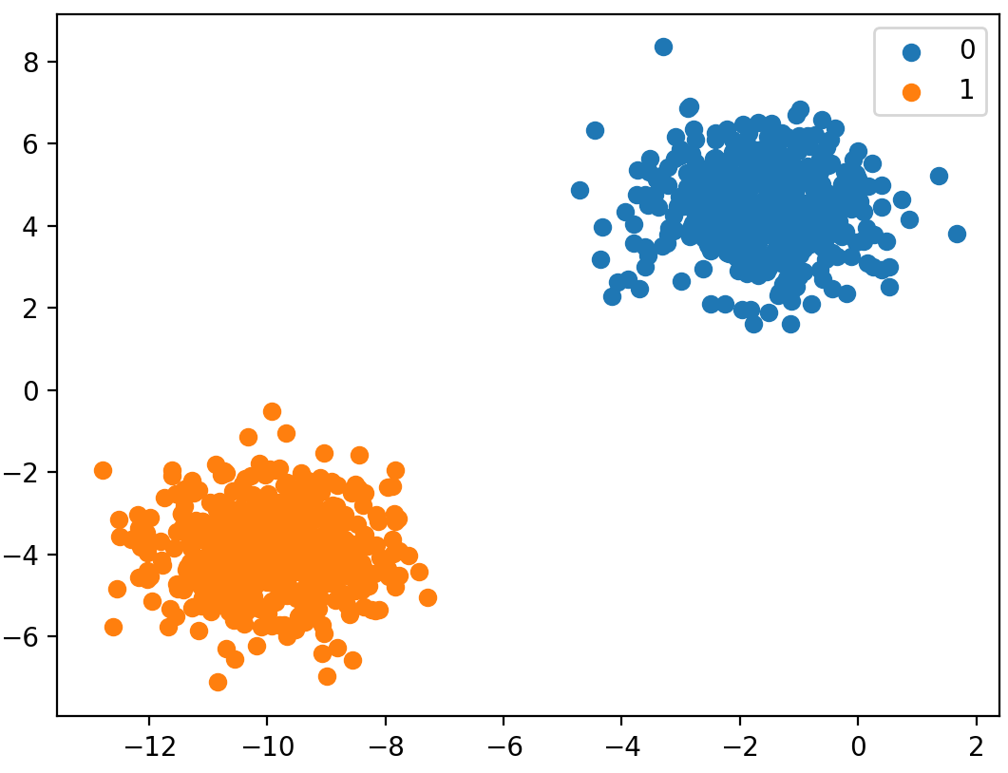
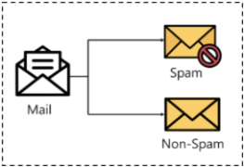
Binary Classification (1/2)
Binary classification refers to those classification tasks that have two class labels.
  Email spam detection (spam or not).
  Churn prediction (churn or not).
  Conversion prediction (buy or not).
Notes:
Typically, binary classification tasks involve one class that is the normal state and another class that is the abnormal state.
The class for the normal state is assigned the class label 0 and the class with the abnormal state is assigned the class label 1.

Slide 4
Binary Classification (2/2)
Popular algorithms that can be used for binary classification include:
  Logistic Regression
  k-Nearest Neighbors
  Decision Trees
  Support Vector Machine
  Naive Bayes

Slide 5
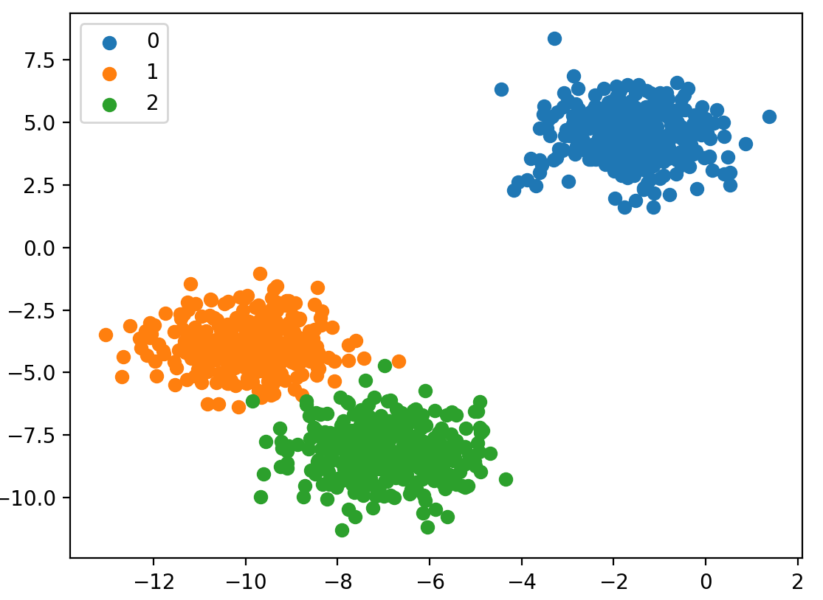
Multi-Class Classification (1/3)
Multi-class classification refers to those classification tasks that have more than two class labels.
  Face classification.
  Plant species classification.
  Optical character recognition
Notes:
Unlike binary classification, multi-class classification does not have the notion of normal and abnormal outcomes. Instead, examples are classified as belonging to one among a range of known classes.
The number of class labels may be very large on some problems. For example, a model may predict a photo as belonging to one among thousands or tens of thousands of faces in a face recognition system.

Slide 6
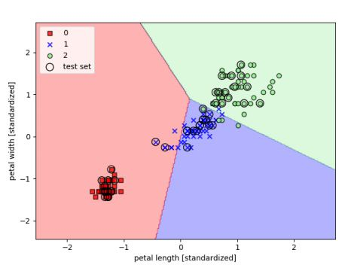
Multi-Class Classification (2/3)
Example: The classification of the Iris flower dataset into its three sub-species indicated by codes 0, 1, and 2.

Slide 7
Multi-Class Classification (3/3)
Many algorithms used for binary classification can be used for multi-class classification.
  k-Nearest Neighbors.
  Decision Trees.
  Naive Bayes.
  Random Forest.
  Gradient Boosting.

Slide 8
Multi-Label Classification (1/2)
This classification tasks have two or more class labels, where one or more class labels may be predicted for each example.
The classification of a photo , which has multiple objects in the scene, such as “bicycle,” “apple,” “person,” etc.
Notes:
Consider the example of photo classification, where a given photo may have multiple objects in the scene and a model may predict the presence of multiple known objects in the photo, such as “bicycle,” “apple,” “person,” etc.

Slide 9
Multi-Label Classification (2/2)
Classification algorithms used for binary or multi-class classification cannot be used directly for multi-label classification.
  Multi-label Decision Trees
  Multi-label Random Forests
  Multi-label Gradient Boosting

Slide 10
Imbalanced Classification
Imbalanced classification refers to classification tasks where the number of examples in each class is unequally distributed.
  Fraud detection.
  Outlier detection.
  Medical diagnostic tests.

Slide 11
Types of ML Classification Algorithms
Classification Algorithms can be further divided into the Mainly two category:
  Linear Models
    Logistic Regression
    Support Vector Machines
  Non-linear Models
    K-Nearest Neighbours
    Kernel SVM
    Naïve Bayes
    Decision Tree Classification
    Random Forest Classification

Slide 12
Performance Metrics
Accuracy
Confusion matrix
Precision
Recall
F1-score

Slide 13
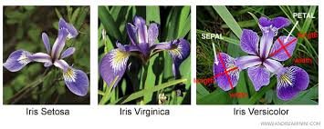
IRIS Data Set (1/2)
The Iris dataset contains measurements of 150 IRIS flowers from three different species:
http://bit.ly/2SlPUbP
Notes:
Each row represents one sample. Flower measurements in centimeters are stored as columns. These are called features.

Slide 14
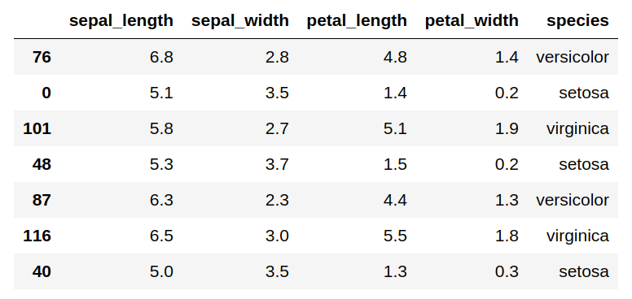
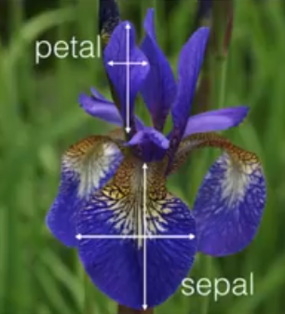
IRIS Data Set (2/2)
There are 150 observations, 4 features(sepal length, sepal width, petal length, petal width), Response variable is the iris species, Classification problem since response is categorical.

Slide 15
scikit-learn library
Implementation of KNN on iris dataset using scikit-learn library.
A KNN model which classifies the new species based on the sepal and petal measurements. Iris dataset is available in scikit-learn and we can make use of it build our KNN.

Slide 17
Step1: Import the required data and check the features.
Step2: Split the data and Train the Model.

Slide 18
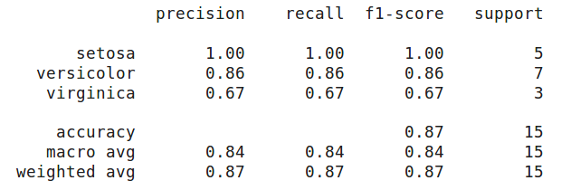
Classification Report
A classification report will give the following results, it is a sample classification report of a classifier using an Iris dataset.

Slide 19
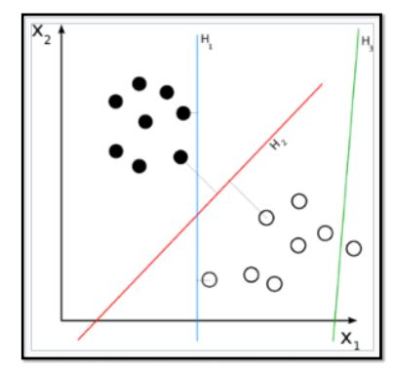
Binary Classification: Example
Social media sentiment analysis has two potential outcomes, positive or negative, as displayed by the chart given below.

Slide 20
Accuracy
Accuracy is a ratio of correctly predicted observation to the total observations.
  True Positive: The number of correct predictions that the occurrence is positive.
  True Negative: Number of correct predictions that the occurrence is negative.

Slide 21

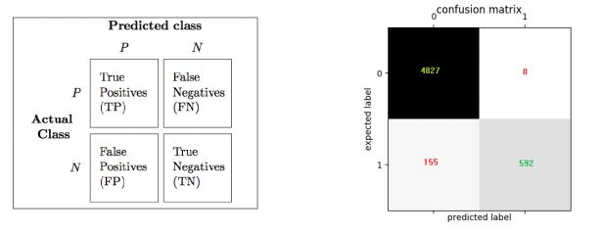
Confusion Matrix
Precision refers to the accuracy of positive predictions.
Notes:
In machine learning, we do not have to define explicitly all the steps or conditions like any other programming application. On the contrary, the machine gets trained on a training dataset, large enough to create a model, which helps machine to take decisions based on its learning.
For example: We want to determine the species of a flower based on its petal and sepal length (leaves of a flower) using machine learning. Then, how will we do it?
We will feed the flower data set which contains various characteristics of different flowers along with their respective species into our machine as you can see in the above image. Using this input data set, the machine will create and train a model which can be used to classify flowers into different categories.
Once our model has been trained, we will pass on a set of characteristics as input to the model.
Finally, our model will output the species of the flower present in the new input data set. This process of training a machine to create a model and use it for decision making is called Machine Learning. However this process has some limitations.

Slide 22
Precision And Recall
Precision is the fraction of relevant instances among the retrieved instances, while recall is the fraction of relevant instances that have been retrieved over the total number of instances. They are basically used as the measure of relevance.
F1-Score is is the weighted average of precision and recall.
https://www.edureka.co/blog/classification-in-machine-learning/

Slide 23
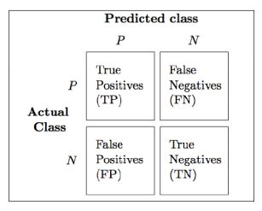
Precision
Precision refers to the accuracy of positive predictions.
Notes:
In machine learning, we do not have to define explicitly all the steps or conditions like any other programming application. On the contrary, the machine gets trained on a training dataset, large enough to create a model, which helps machine to take decisions based on its learning.
For example: We want to determine the species of a flower based on its petal and sepal length (leaves of a flower) using machine learning. Then, how will we do it?
We will feed the flower data set which contains various characteristics of different flowers along with their respective species into our machine as you can see in the above image. Using this input data set, the machine will create and train a model which can be used to classify flowers into different categories.
Once our model has been trained, we will pass on a set of characteristics as input to the model.
Finally, our model will output the species of the flower present in the new input data set. This process of training a machine to create a model and use it for decision making is called Machine Learning. However this process has some limitations.

Slide 24
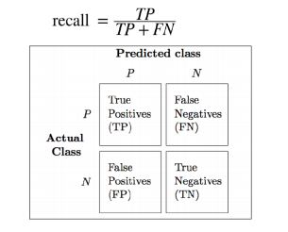
Recall
Recall refers to the ratio of positive instances that are correctly detected by the classifier.
Also known as True positive rate or TPR.
Notes:
In machine learning, we do not have to define explicitly all the steps or conditions like any other programming application. On the contrary, the machine gets trained on a training dataset, large enough to create a model, which helps machine to take decisions based on its learning.
For example: We want to determine the species of a flower based on its petal and sepal length (leaves of a flower) using machine learning. Then, how will we do it?
We will feed the flower data set which contains various characteristics of different flowers along with their respective species into our machine as you can see in the above image. Using this input data set, the machine will create and train a model which can be used to classify flowers into different categories.
Once our model has been trained, we will pass on a set of characteristics as input to the model.
Finally, our model will output the species of the flower present in the new input data set. This process of training a machine to create a model and use it for decision making is called Machine Learning. However this process has some limitations.

